Slide 1
2022 Club 7s update
Committee – working group assembled, committee being finalized (still trying to connect with a few people)
Venue –
Was working bids with Empire and Mid Atlantic – venue issues prevented execution
Had discussions with Winston-Salem (venue issue), Birmingham (logistics issue), Boston (venue issue), Seattle (venue issue) but none are viable
Hoping to hear back on Columbus, OH (Obetz) and a few others
Actively seeking suitable venue (2,500+ seat stadium, 4 total fields, major airport, streaming capabilities, grass, sleeved goal posts, no conflicting lines)
Pathway (Signes – Silver will be open for regional series teams)
Men – 13 seeds allocated to regional series / 3 invitational
Women – working with committee to develop pathway that considers current landscape

Slide 2
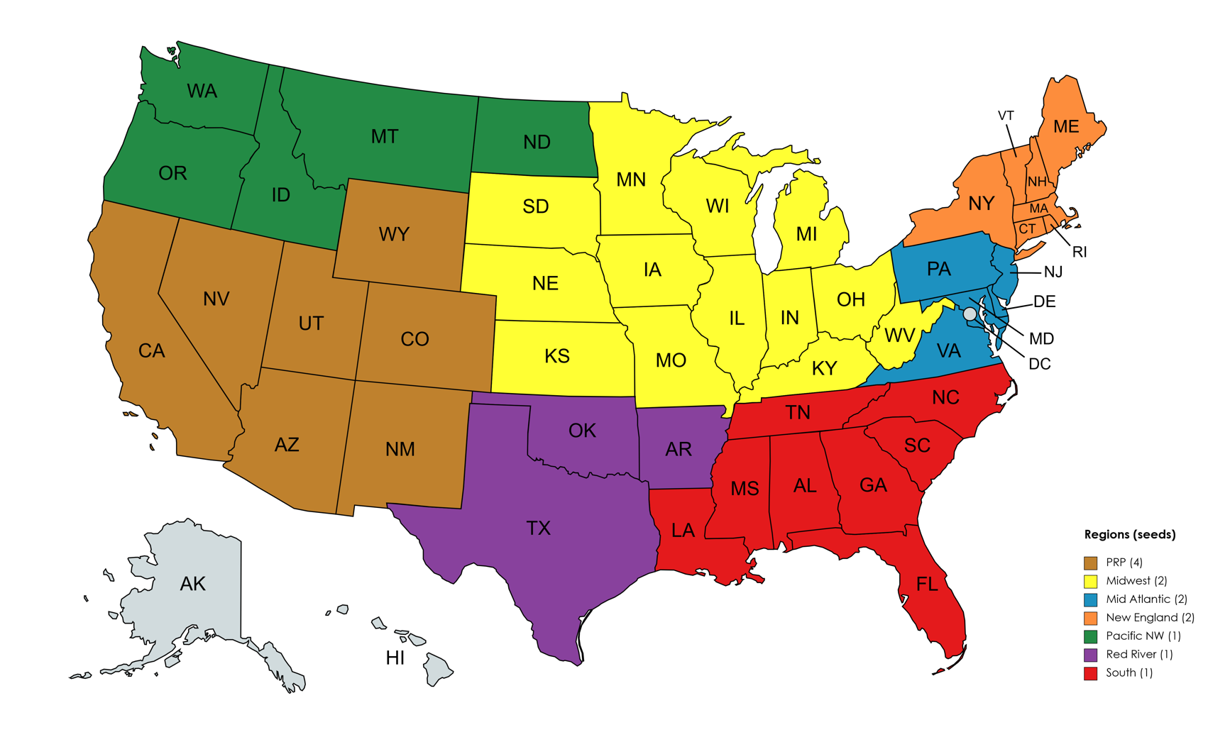
series/ seed structure
Series based on combination of existing infrastructure and historical strength of region
Seeds are not finalized (based on strength of teams and % of registered players)

